Slide 1
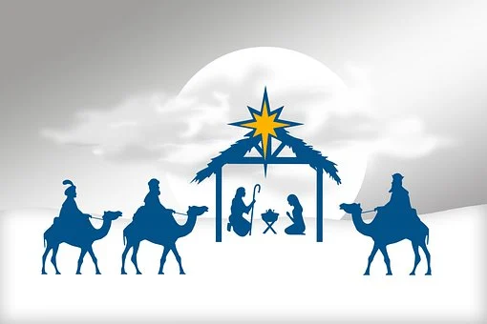
St Peter’s Medical Centre
Christmas & New Year Opening Hours
Saturday 23rd December 2023 to Wednesday 26th December 2023.
This surgery will be closed
We are open thereafter
Wednesday 27th December 2023 8am to 6:30pm
Thursday 28th December 2023 8am to 6:30pm
Friday 29th December 2023 8am to 6:30pm
Saturday 30th December 2023 to Monday 1st January 2024.
This surgery will be closed
This surgery will re-open after the Bank Holiday period on Tuesday 2nd January 2024 at 8am
Please call NHS 111
for out of hours help and advice
and 999 for any emergency

